Slide 1
APRIL FINANCIAL/ ENROLLMENT REPORT
Board Meeting April 25, 2024

Slide 2
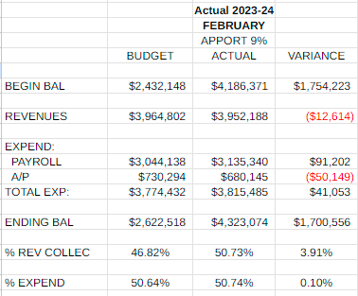
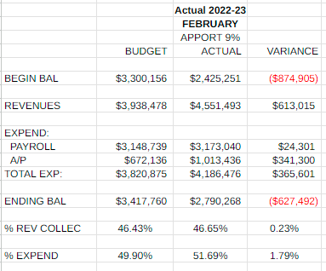
Monthly Revenues, Expenditures and Fund Balance Compared to Projected - February
Revenues for the month are very close to projected. Due to the tax collections for the year (all in the fall and almost nothing in the spring), we have received 3.91% more revenues than projected, compared with .23% last year. This makes sense. Again we spent more in payroll than projected and this month we spent more than projected in expenditures. However, we are still spending much less for the year in comparison with last year (.10 more than projected this year and 1.79% more last year). I will have full revenue, expenditure and fund balance projections next month.

Slide 3
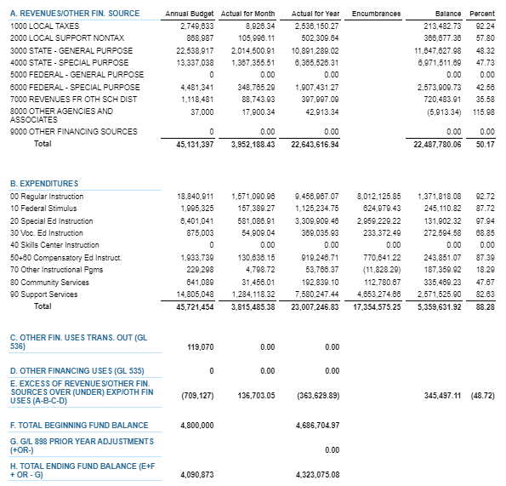
FEBRUARY 2024 BUDGET STATUS REPORT – GENERAL FUND

Slide 4
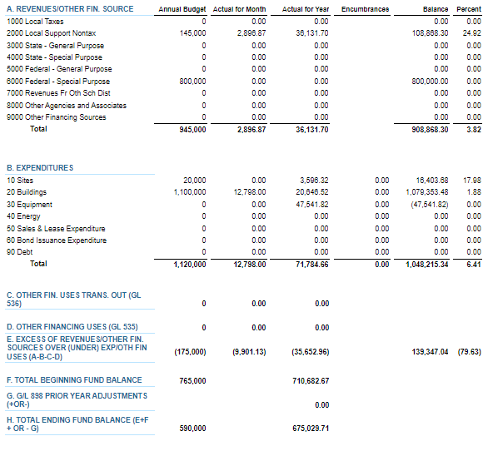
FEBRUARY 2024 BUDGET STATUS REPORT – CAPITAL PROJECTS FUND

Slide 5
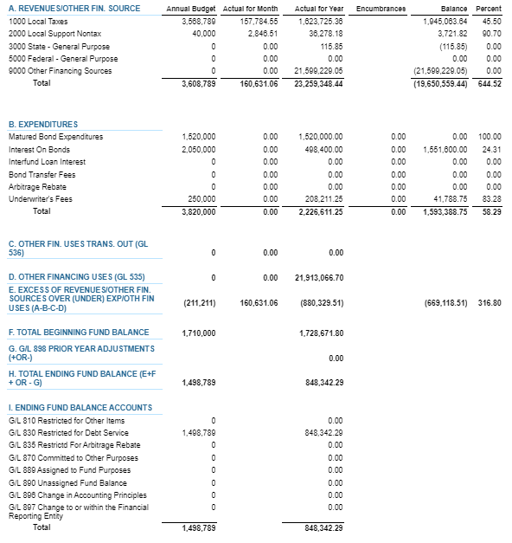
FEBRUARY 2024 BUDGET STATUS REPORT – DEBT SERVICE FUND

Slide 6
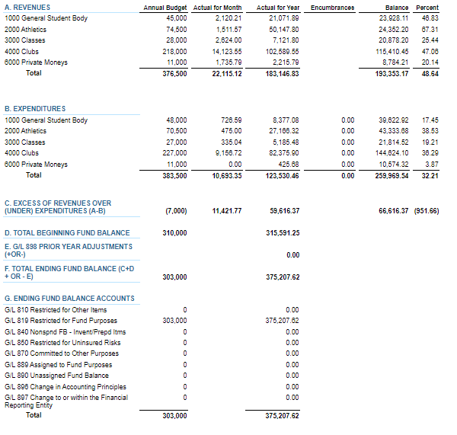
FEBRUARY 2024 BUDGET STATUS REPORT – ASB FUND

Slide 7
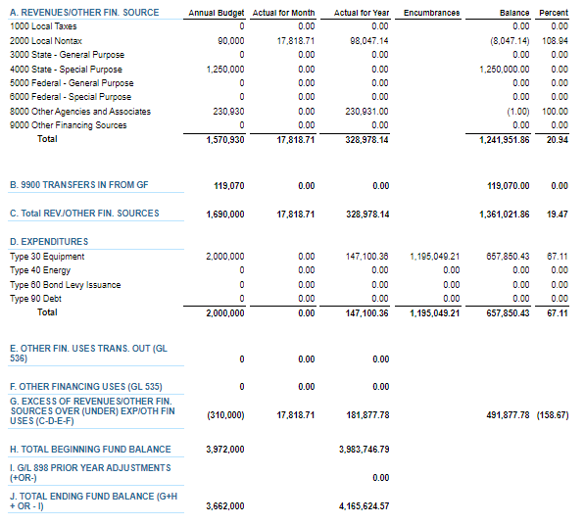
FEBRUARY 2024 BUDGET STATUS REPORT – TRANSPORTATION VEHICLE FUND

Slide 8
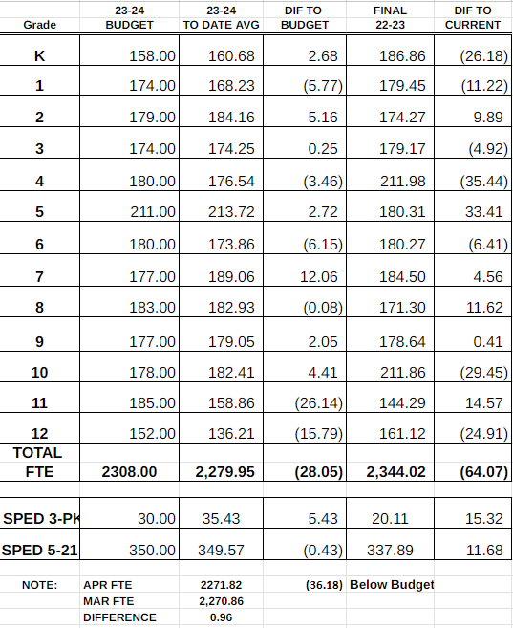
FTE ENROLLMENT – APRIL 2024

Slide 9
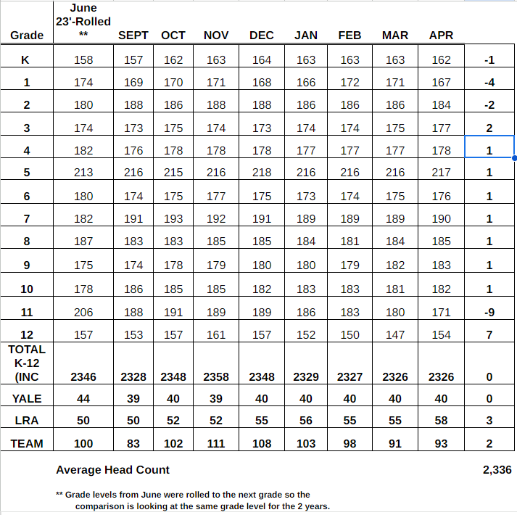
HEADCOUNT ENROLLMENT – APRIL 2024

